Slide 1

Daily Top 50 - Global @ 16:57:07 17/01/2023
By Timothy Cameron

Slide 2
Top 5 Songs

Slide 3

1 - Flowers
By Miley Cyrus. Album - Flowers

Slide 4

2 - Shakira: Bzrp Music Sessions, Vol. 53
By Bizarrap, Shakira. Album - Shakira: Bzrp Music Sessions, Vol. 53

Slide 5

3 - Kill Bill
By SZA. Album - SOS

Slide 6

4 - Creepin' (with The Weeknd & 21 Savage)
By Metro Boomin, The Weeknd, 21 Savage. Album - HEROES & VILLAINS

Slide 7

5 - Unholy (feat. Kim Petras)
By Sam Smith, Kim Petras. Album - Unholy (feat. Kim Petras)

Slide 8
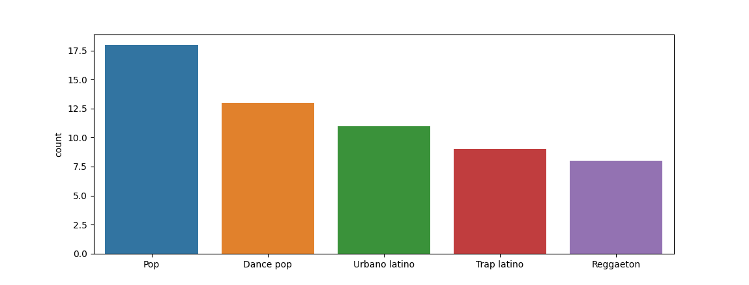
Most Popular Genres

Slide 9
Audio Features

Slide 10
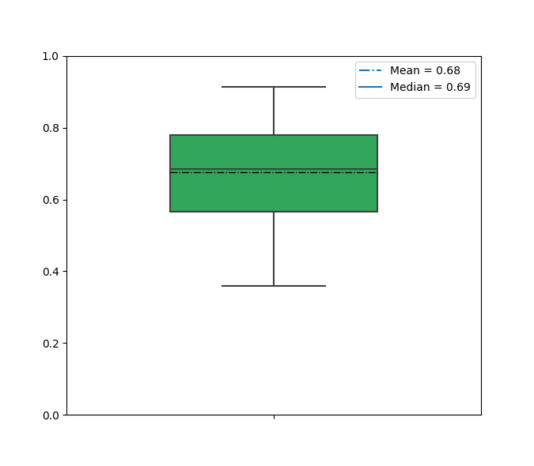
Danceability
Danceability describes how suitable a track is for dancing based on a combination of musical elements including tempo, rhythm stability, beat strength, and overall regularity. A value of 0.0 is least danceable and 1.0 is most danceable.

Slide 11
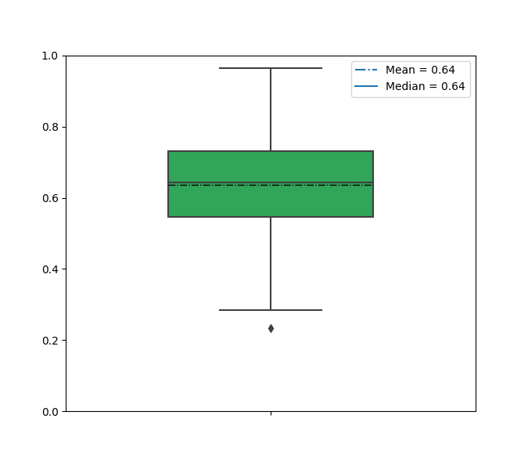
Energy
Energy is a measure from 0.0 to 1.0 and represents a perceptual measure of intensity and activity. Typically, energetic tracks feel fast, loud, and noisy. For example, death metal has high energy, while a Bach prelude scores low on the scale. Perceptual features contributing to this attribute include dynamic range, perceived loudness, timbre, onset rate, and general entropy.

Slide 12
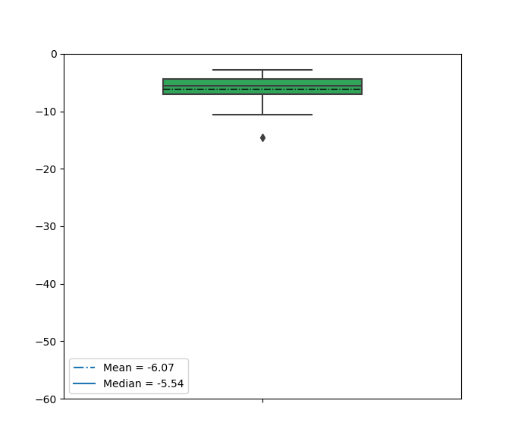
Loudness
The overall loudness of a track in decibels (dB). Loudness values are averaged across the entire track and are useful for comparing relative loudness of tracks. Loudness is the quality of a sound that is the primary psychological correlate of physical strength (amplitude). Values typically range between -60 and 0 db.

Slide 13
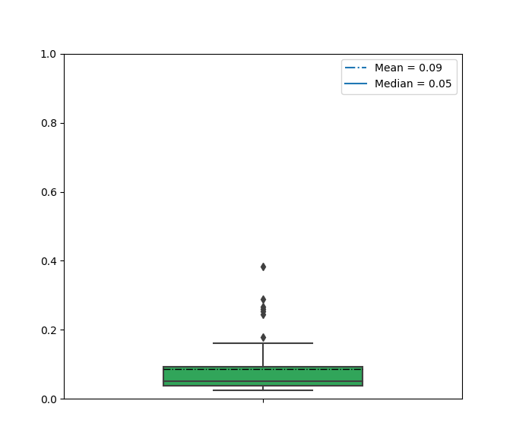
Speechiness
Speechiness detects the presence of spoken words in a track. The more exclusively speech-like the recording (e.g. talk show, audio book, poetry), the closer to 1.0 the attribute value. Values above 0.66 describe tracks that are probably made entirely of spoken words. Values between 0.33 and 0.66 describe tracks that may contain both music and speech, either in sections or layered, including such cases as rap music. Values below 0.33 most likely represent music and other non-speech-like tracks.

Slide 14
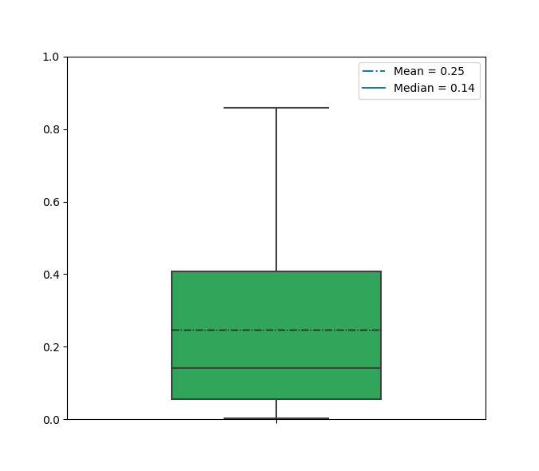
Acousticness
A confidence measure from 0.0 to 1.0 of whether the track is acoustic. 1.0 represents high confidence the track is acoustic.

Slide 15
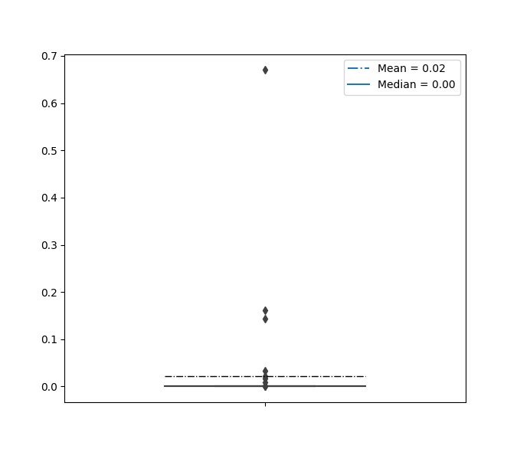
Instrumentalness
Predicts whether a track contains no vocals. "Ooh" and "aah" sounds are treated as instrumental in this context. Rap or spoken word tracks are clearly "vocal". The closer the instrumentalness value is to 1.0, the greater likelihood the track contains no vocal content. Values above 0.5 are intended to represent instrumental tracks, but confidence is higher as the value approaches 1.0.

Slide 16
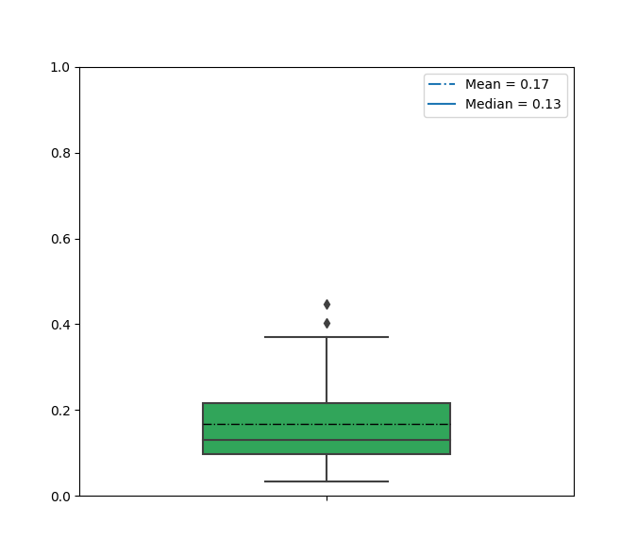
Liveness
Detects the presence of an audience in the recording. Higher liveness values represent an increased probability that the track was performed live. A value above 0.8 provides strong likelihood that the track is live.

Slide 17
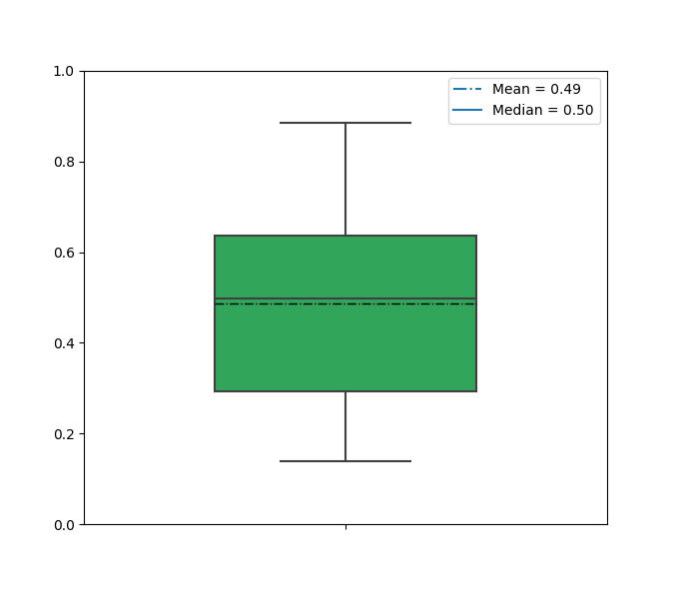
Valence
A measure from 0.0 to 1.0 describing the musical positiveness conveyed by a track. Tracks with high valence sound more positive (e.g. happy, cheerful, euphoric), while tracks with low valence sound more negative (e.g. sad, depressed, angry).

Slide 18
Thank you!
Please refer to Daily Top 50 - Global.csv for the extracted results.

